Slide 1

Introduction to R
Sponsored by: The Graduate Research Commons & KEY
Facilitator/Helper: Alice Roberts & Laura Gutierrez Funderburk

Slide 2
Schedule for October 5
10:30 – 11:45 | Introductions and Basic Programming
11:45 – 12:00 | Coffee Break
12:00 – 1:30 | Basic Programming
1:30 – 2:30 | Lunch Break
2:30 – 3:45 | Data Structure and Organization
3:45 – 4:00 | Coffee Break
4:00 – 5:30 | Data Structure and Organization (cont)

Slide 3
Schedule for October 6
10:30 – 11:45 | Statistical Analysis
11:45 – 12:00 | Coffee Break
12:00 – 1:30 | Statistical Analysis (cont)
1:30 – 2:30 | Lunch Break
2:30 – 3:45 | Plotting with R
3:45 – 4:00 | Coffee Break
4:00 – 5:30 | Importing/Exporting Data; Markdown

Slide 4
Before we begin..
Use of sticky notes
No question is a stupid question

Slide 5
Quick Intro
Name
Background
Current software – Excel, MATLAB, etc.
Experience with R/RStudio
Expectation from workshop

Slide 6
Module 1: Intro to programming
& the R environment

Slide 7
What can R help you with?
Cleaning the data
Filtering data
Handling Null or NAs
Mathematical calculations – log , sq. root
String operations – concatenation, regex
Statistical analyses – t tests, ANOVAs
Visual representation of data – histogram, bar plot
and list goes on..

Slide 8
Why use R over Excel?
Faster computations
Easy project organization
Better graphics (easily customizable too)
Advanced statistic capabilities
Automation + Reproducibility

Slide 9
Why R?
R provides a way to do quantitative analysis
Computationally advantageous
Ability to handle and sort large data sets
Flexibility in statistical analysis
Text visualization and graphics
Open source (i.e. continually updated and free)

Slide 10
Objectives
Learn Basic R commands
Learn how to think about programming
Connecting data structure, functions, available information, and statistical tests
Learn basic trouble-shooting skills

Slide 11
For help after the course:
Email me: lgutierr@sfu.ca
Go to the Scientific Programming Study Group
http://sciprog.ca/
Go to the UBC R Study Group
https://minisciencegirl.github.io/studyGroup/
Use Google, stackoverflow

Slide 12
This is what R looks like:

Slide 13
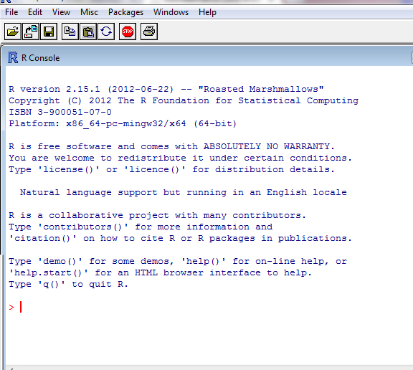

Slide 14
The Command Line

Slide 15
Disadvantages
You cannot go back to edit previous code
What happens if you make a mistake?
You can’t easily see your previous code
If you exit R, although you can save everything you’ve done, you loose the code of what you did to create it
It is impossible to collaborate

Slide 16
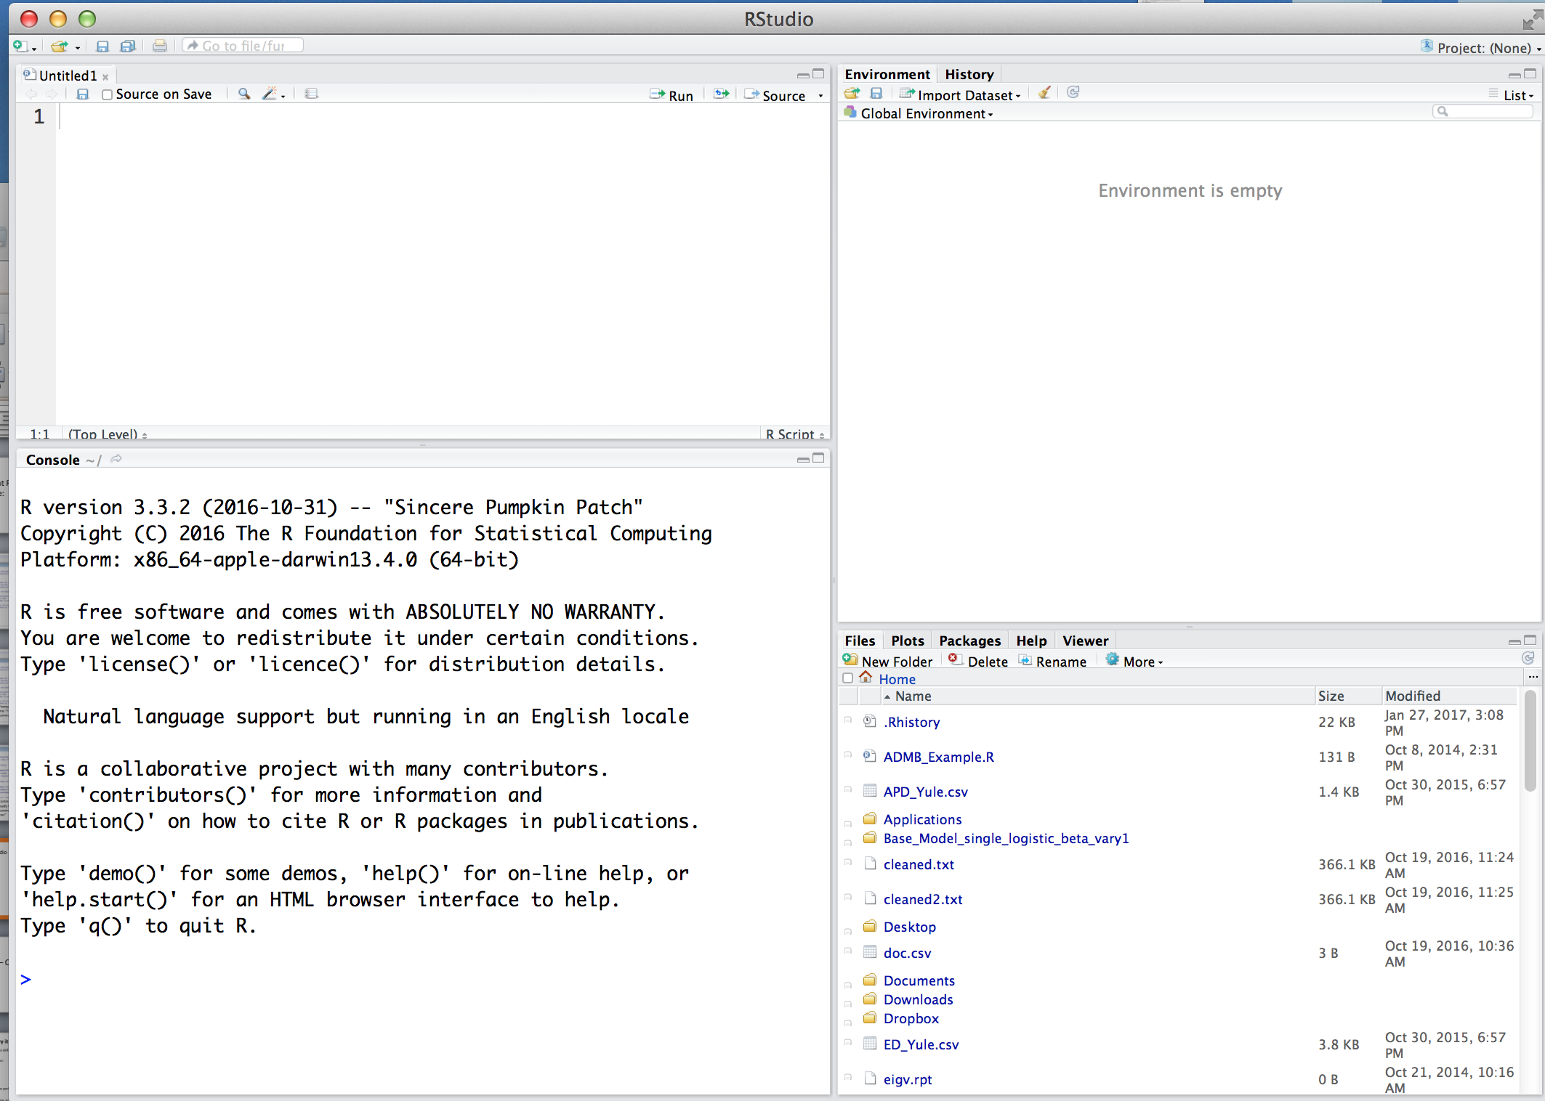
R Studio
Notes:
IDE for developing programs in R
R: programming langugage for statistical calculations.
1

Slide 17
R Studio
Everything here is part of your workspace

Slide 18
R Studio
Text Editor to write Script
Workspace info
Helpful tools
(Plots, Help, Files, etc.)
The R Console

Slide 19
R Studio
Text Editor to write Script
Workspace info
Helpful tools
(Plots, Help, Files, etc.)
The R Console
Notes:
Switch to Rstudio to write a script with print(“helloworld”)
1

Slide 20
Scripts
A series of commands written in a text editor and saved with a “.r” extension so they can be re-run, or “sourced”, to R on a different occasion

Slide 21
Why use a script?
Allows fast editing, troubleshooting, and sharing
Example programs
R editor, TinnR, RStudio, Sublime

Slide 22
Things to include in an R script
A short description of what the script does - comments
The last time the script was updated
Lots and lots of notes!
Notes:
1

Slide 23
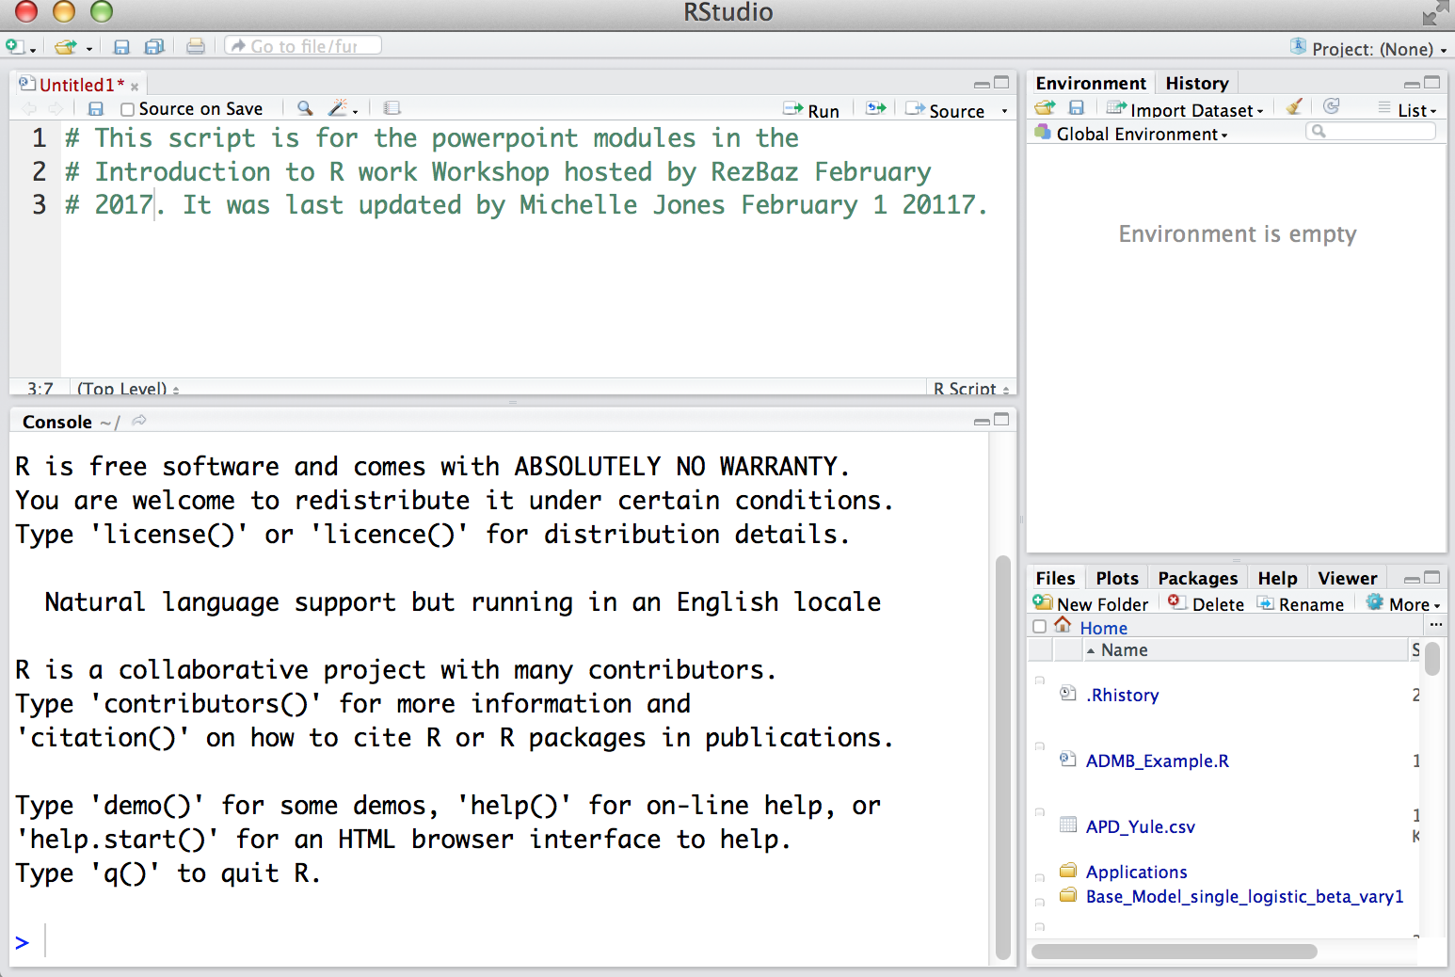
Example R Script
Notes:
1

Slide 24
Example R Script
*Notice each line has a hashtag. This will tell R you are making comments, not trying to deliver commands.
Always put more notes in a script than you think you need because in a week your memory won’t be as good as you think
Notes:
Switch - Go back and add a personal comment using #. Maybe today’s date.
1

Slide 25
Connecting to R
If you aren’t working in R, how do you get commands from the script to R?
Select the “run” icon from R studio
Send directly to R with the keyboard short cut:
Mac: CMD + Enter
Windows: CTRL + R
Notes:
Switch: now run that print command and try other print statements too
1

Slide 26
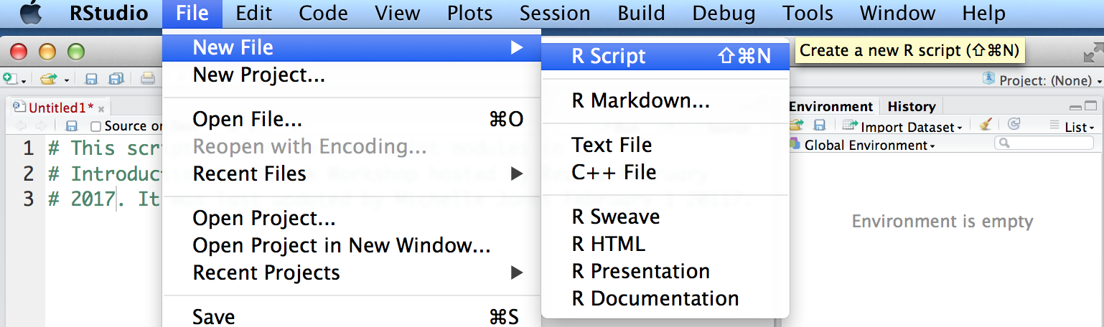
Your turn
Open R studio and start a script for today’s workshop
If you do not have a script panel open up automatically go to file>newscript

Slide 27
The Working Directory
The working directory is the pathway to the folder that R is currently connected to. R can only be in one folder of your computer at a time.
All data, other scripts, etc. must be in the same folder as the working directory, although the working directory can be changed many times in 1 script
All plots and files saved from R will go to the working directory
To know where R is working from:
getwd()
Notes:
switch
1

Slide 28
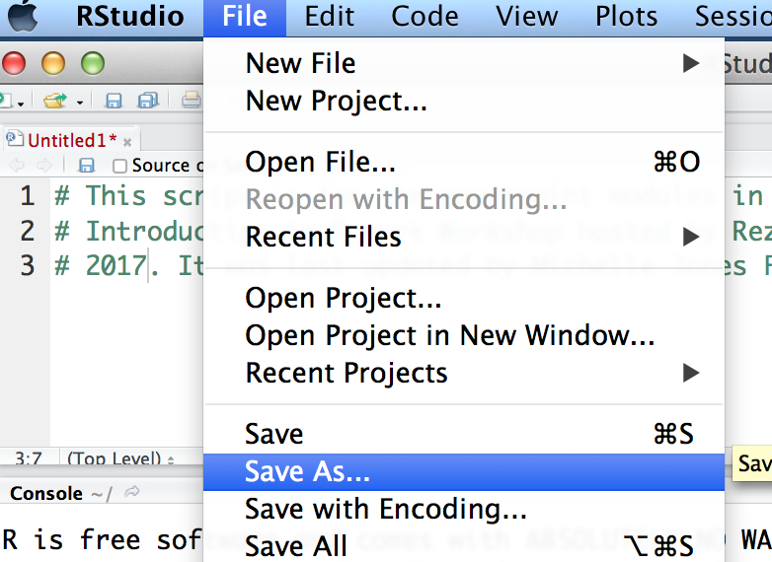
Lets set up a working directory
Create a folder on the desktop for today’s workshop called “R.Intro”
Save the script you’ve already started into the new folder making sure you use a .r extension

Slide 29
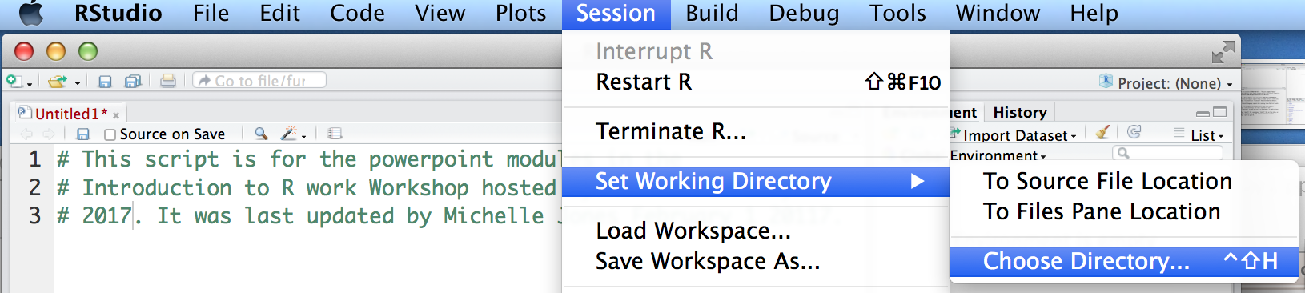
Lets set up a working directory
Create a folder on the desktop for today’s workshop called “R.Intro”
Save the script you’ve already started into the new folder making sure you use a .r extension
Now change the working directory in R to go to this folder:

Slide 30
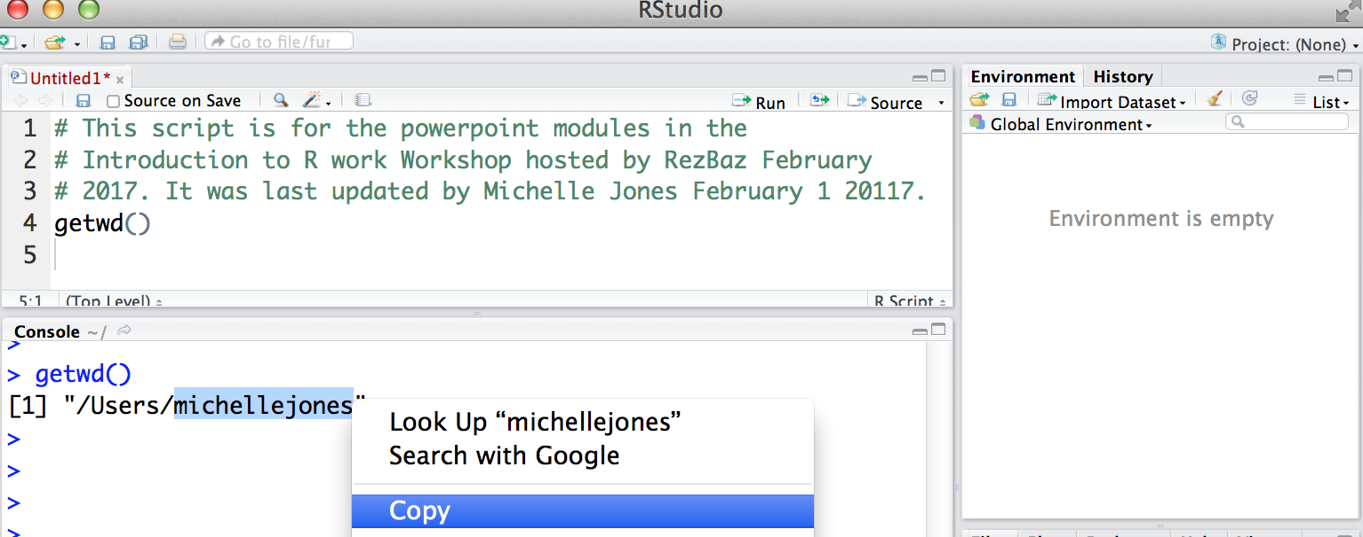
Lets set up a working directory
Once you’ve set the working directory once, copy and paste the pathway back into your script.
This way you don’t need to set it manually every time this script is opened
First, use the getwd() command to print the pathway and copy it to clipboard from the R console
Notes:
1

Slide 31
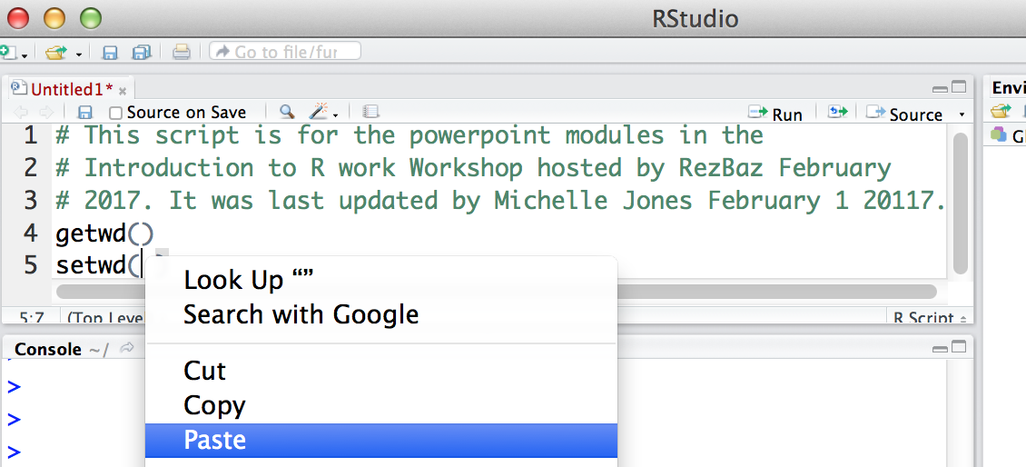
Lets set up a working directory
Second, paste the pathway into the setwd() command which manually sets your working directory

Slide 32
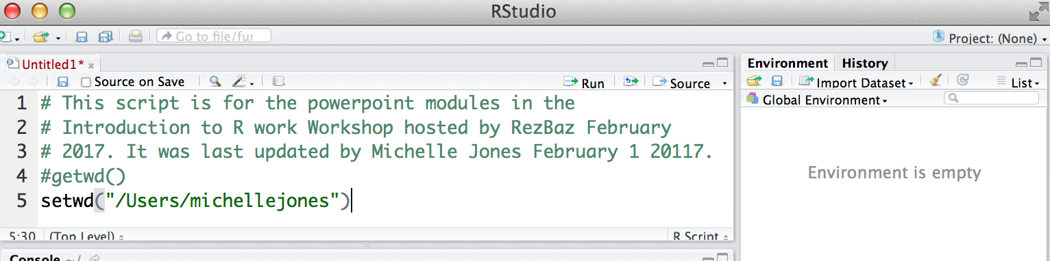
Lets set up a working directory
Finally, comment out the command to get the working directory.
Now, every time you run this script it will automatically synch to this folder.
If you change the location of this folder on your computer after the workshop, you will need to change the pathway in your script

Slide 33
And, we’re ready to go!

Slide 34
Basic R terminology
When you save a series of calculations you place them in an object
To assign an object use <-
“object name”<- “something you want to save”
> example1<-1+3+4*10
To see what an object contains, type it’s name > example1
Notes:
switch
1

Slide 35
When you assign your calculations into an object, you actually have to open the object to see what is inside
Example 1
All the calculations are saved in your object
Step one: Put in object
example1<-1+3+4*10
Example 1
Results from your all the calculations are saved in your object
Step two - open the object:
example1

Slide 36
Your turn
Make the following two objects:
> object1<-1+4+5
> object2<-5*2
Print out what is inside these objects
> object1
> object2
Now add the two objects together
>object 1+object2
We save things in objects so that we can access them in subsequent calculations (e.g. object1 +object2)

Slide 37
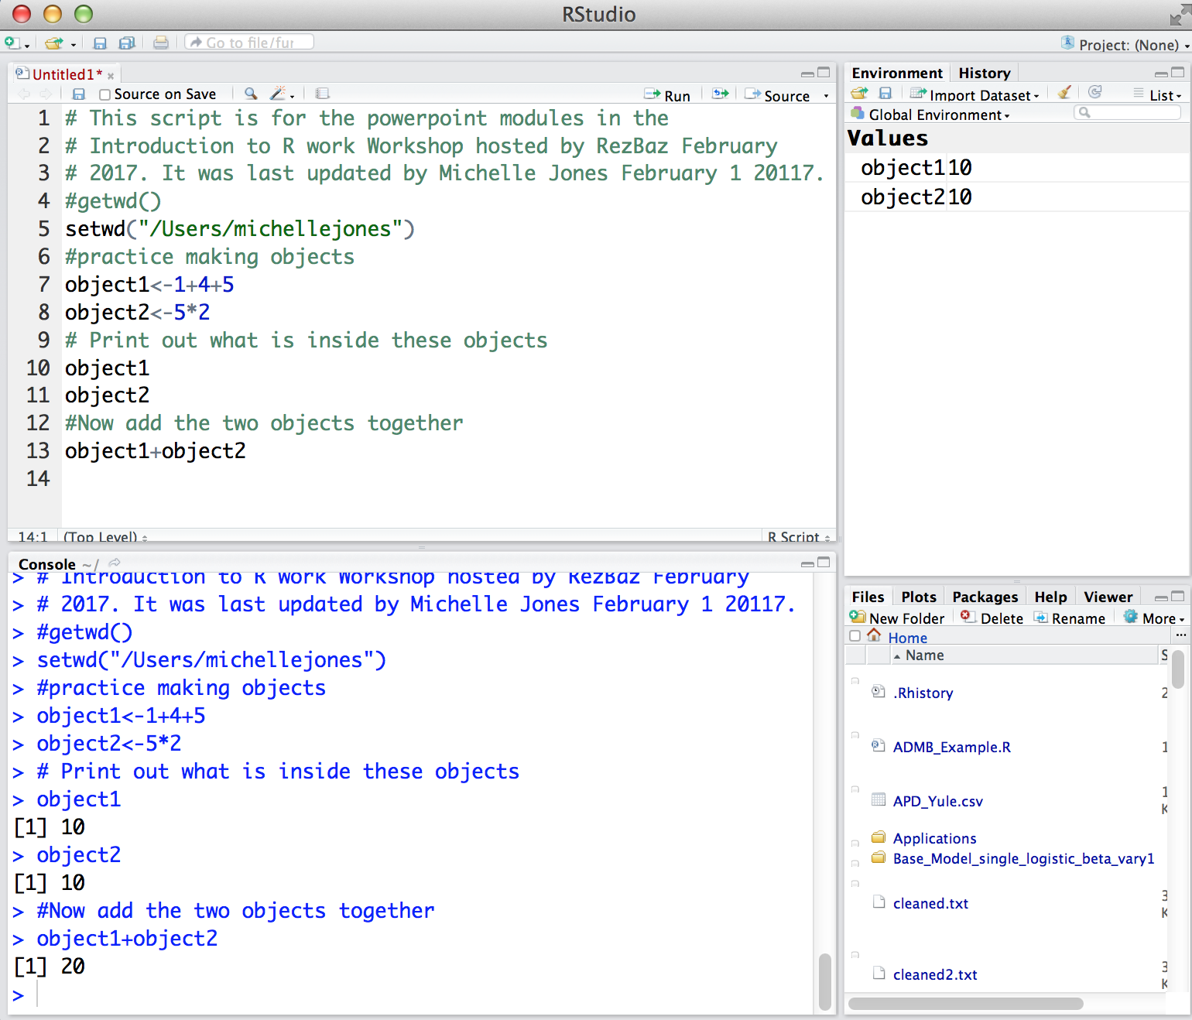

Slide 38
To see all the objects in your workspace
ls()
or
objects()
To remove an object rm()
rm(“object1”)
Notes:
switch
1

Slide 39
General Programming Tips
Use a new folder for each project
Annotate your script – using the “#” symbol allows you to write notes within a script
Use explicit names when saving objects
Be systematic

Slide 40
Other Math Functions
x <- 10
> log(x) # log base e
> log10(x) # log base 10
> exp(x) # e raised to x
> abs(-x) # absolute value
> sqrt(x) # square root
Notes:
switch
1

Slide 41
Logical Tests – Good for Sorting Data
i.e – is this true?
(Valuable for filtering– e.g. If this is true then…..)
X<-2 Y<-3
> X == Y # Test for equivalence
> X != Y # Test for non-equivalence
> X > Y # Greater than
> X < Y # Less than
> X >= Y # Greater than or equal to
> X <= Y # Less than or equal to
Notes:
switch
1

Slide 42
Trig Functions
x <- seq(from = 0.1, to = 1, by = 0.1)
> sin(x) # sine
> cos(x) # cosine
> tan(x) # tangent
> asin(x) # arc-sine
> acos(x) # arc-cosine
> atan(x) # arc-tangent
> pi # 3.14159……
Notes:
switch
1

Slide 43
Concept Check
Make three objects named X, Y and Z.
In X, put the product of 5 and 4
In Y, put the sum of 5 and 5
In Z, put the difference between 30 and 10
List all the objects that are now stored in R
Test to see if Z and X are equivalent
If they are, remove one of them from the R workspace and list all objects
If you wanted your deleted object back, what could you do?

Slide 44
Concept Check Answers
Objects X, Y, Z
X<-5*4
Y<-5*5
Z<-30-10
See all objects
ls()
Test equivalence
Z==X
Remove Z
rm(Z)

Slide 45
Basic Stats
x <- 1:100
> mean(x) # average
> median(x) # median
> var(x) # variance
> sd(x) # standard deviation
> quantile(x) # main quantiles
> max(x) # maximum value
> min(x) # minimum value
> summary(x) # summary statistics
Notes:
switch
1

Slide 46
Things that make R powerful
Packages: Pre-written code used to solve specific problems
Pre-installed packages
library(“package name”)
ex/MASS
User-installed packages
install.packages(“”)
ex/install.packages(“RMark”)
Packages are only installed once and saved to the library. Packages must be loaded during each R session.

Slide 47
Help Functions
R has extensive documentation for every function and package
Ex/
help(package=“name of package")
help(plot) # view help for function plot
?plot # same as help(plot)
Google

Slide 48
Help File Format
name {} (package where it exists)
Description – What the command does
Usage – how to type the command
Default arguments (….) - what happens with no specifications
Arguments – different options for customizing the command
Value – what will be returned

Slide 49
Help File Format (cont..)
See also – similar commands of interest, or other functions used in the background
Details – specific considerations in the command
References
Examples

Slide 50
Open a help file
Type this command into the R console:
> help(mean)
Notes:
switch
1

Slide 51
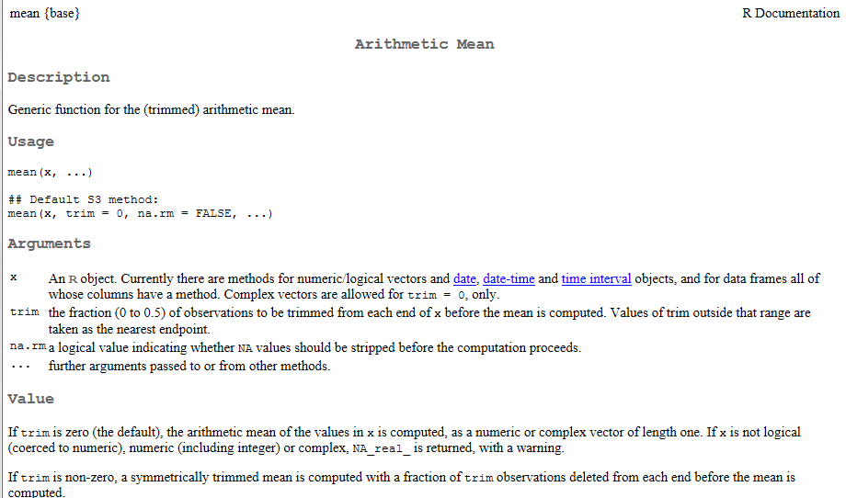
Package where the function lives
How to write the command in R
Defaults if you neglect to make different specifications
Inputs and options to customize the function
Output from the command

Slide 52
Warnings versus Errors
Warning: Something unusual happened, but the code still ran
>x<-c(1,2,-2,4,5)
> sqrt(x)
Error: The function could not be completed
x <- rnorm(10)
y <- rnorm(11)
> cor(x, y)
Notes:
switch
1

Slide 53
End Module One
Questions?

Slide 54
5 Minute Stretch!

Slide 55
Module 2: Data Structure & Organization

Slide 56
Data Structures
Data is stored as a Data Structure, which limits the types of data that it can store (e.g. numeric vs. character vs. both), as well as the operations that can be performed.
Structures include:
Vectors
Matrices
Data frames
Lists
Arrays (not covered)
Defining the wrong kind of data structure is the most common error for beginners

Slide 57
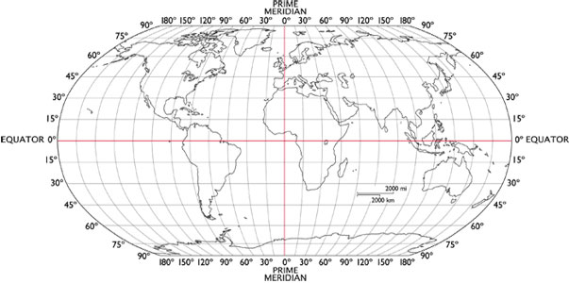

Programming is a Visual Exercise
All data can be referenced by it’s position within data structures, which is often indexing, subseting, loops, functions, and other advanced programming
If forget all the directions, you will never be able to find it.
Getting to Canada requires 2 directions Getting to a building only requires 1

Slide 58


Slide 59
Data Structures
Vectors: One dimension, all entries must be same class
Matrix: Two dimensions, all entries must be same class
Data frames: Two dimensions, entries can be mixed in type among columns but not rows
List: mixed dimensions saved within components of varied data types

Slide 60
Data Classes
The class of data is the kind of information it contains and tells R what kind of functions can be performed on it.
x <- c(1, 2, 3, 4, 5) # numeric
y <- c("A", "B", "C", "D") #character
u <- c(TRUE, FALSE, FALSE, TRUE) #logical
class(y) #character
class(u) #logical

Slide 61
The “is” function
Example: Is x being treated as numeric, character, or factor data?
x<-10
is.numeric(x)
is.character(x)
is.factor(x)

Slide 62
You can change the class temporarily
X<-10
> X+1
> as.character (X)+1
> class(X) # x is still numeric
> X+1
Or change it’s class permanently
> X=as.character(X)
> class(X) # is no longer numeric
> X+1 #no longer woks because X is a character

Slide 63
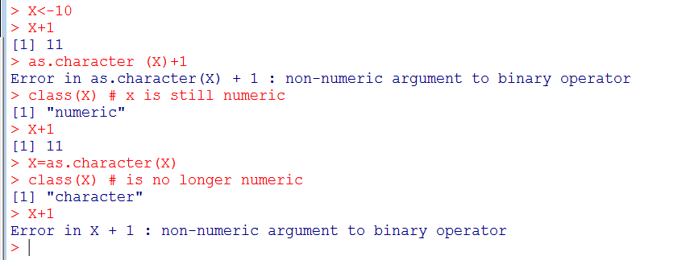
Note this is still an error because of the permanent reassignment

Slide 64
Factors
Vectors displayed as characters that correspond to numbers (sorts in alphabetical order)
(e.g. female=1, male=2)
Typically things we create as category names or groupings
(e.g. nested plot experimental designs, patient gender, patient risk category, province, etc.)
Each group is a factor “level”

Slide 65
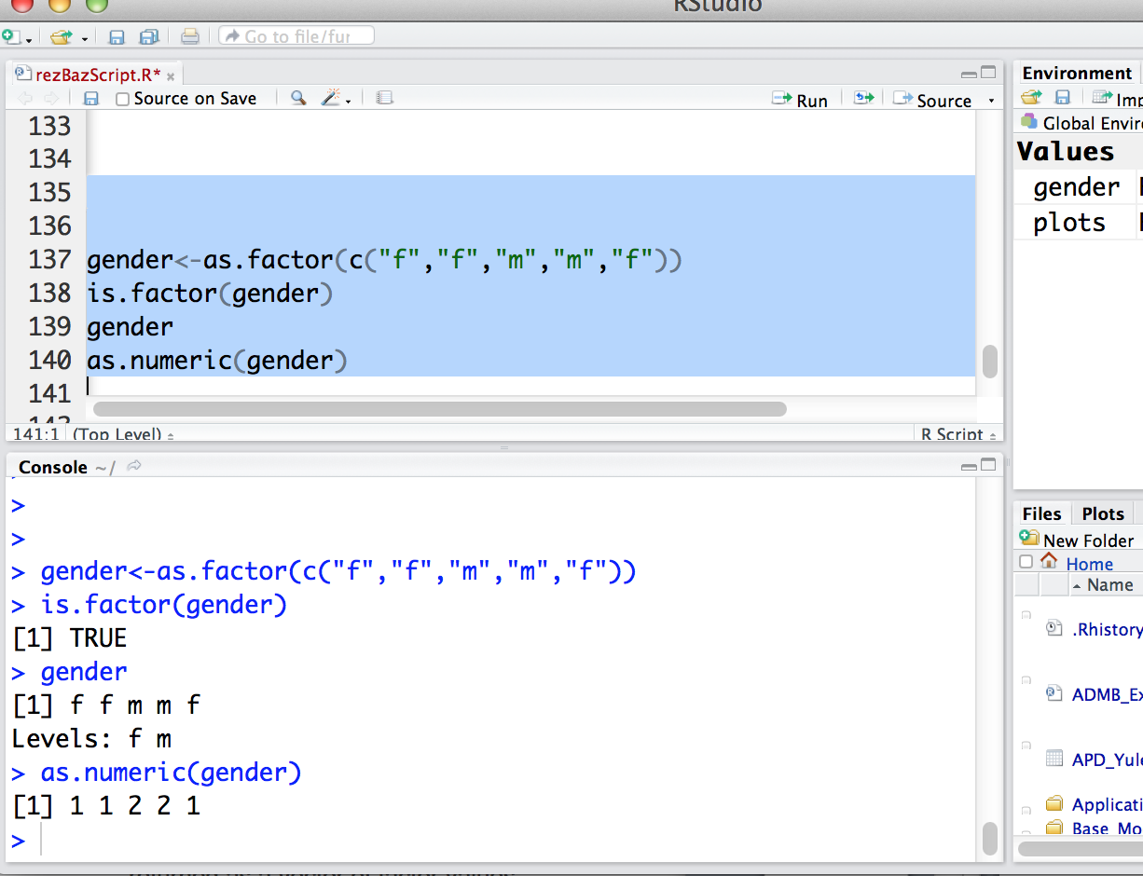

Slide 66
Factors
Converting between factors and numeric values can potentially lead to mistakes
Once numeric values are converted to factors, they are associated with consecutive numbers based on an ascending order of rank
Converting back to numeric values gives the rank, not the original number

Slide 67
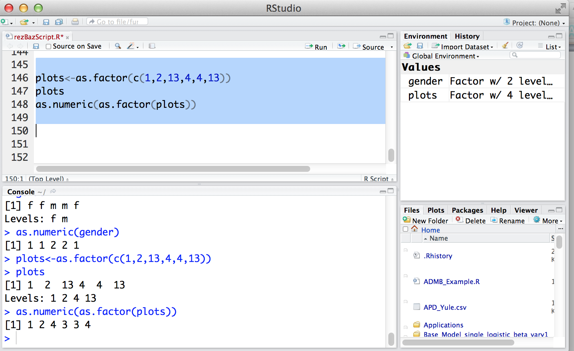

Slide 68
Vectors
A vector is a one dimensional, ordered collection of numbers, strings, etc.
1, 2, 3, 4, 5
A, B, C, D, E, F
TRUE, FALSE, FALSE, TRUE
blue, red, purple, orange

Slide 69
Creating Vectors
> x <- c(1, 2, 3, 4, 5) # concatenate
> y <-c("A", "B", "C", "D“)
> u <- c(TRUE, FALSE, FALSE, TRUE)
> z1 <- seq(from = 1, to = 5, by = 1)
> z2<- 1:5
How would you see if z1 and z2 differ?
Try it!
Notes:
Z1==z2
1

Slide 70
Concept Check
y<-c(1,2)
How is the command :
> r <- rep(y, times = 10)
different from :
> r2<-rep(“y”, times=10)

Slide 71
Concept Check Answers
y<-c(1,2)
The command :
> r <- rep(y, times = 10)
Repeats the object y 10 times.
The command:
> r2<-rep(“y”, times=10)
Repeats the letter y 10 times.

Slide 72
Brackets and Parentheses
R indexes positional information about data in square brackets [ ]
x[2] # “the second entry in vector x”
R operates on and constructs data through parentheses ( )

Slide 73
Subsetting Data
Subsetting is when you extract a certain portion (subset) of the data structure
x <- 15:25
> x[3] # the third entry in x
> x[5:8] # the 5th through the 8th entry in x
> x[x > 18] #all values where x is greater than 18
> x[c(2,5,8)] # take out the 2nd, 5th, and 8th value in X
CONCEPT CHECK
Can you guess what this statement means?
> x[x !=18]
How would you save these entries for later use?

Slide 74
Subsetting
Subsetting is when you extract a certain portion (subset) of the data structure
x <- 15:25
> x[3] # the third entry in x
> x[5:8] # the 5th through the 8th entry in x
> x[x > 18] #all values where x is greater than 5
> x[c(2,5,8)] # take out the 2nd, 5th, and 8th value in X
CONCEPT CHECK
Can you guess what this statement means?
> x[x !=18]
How would you save these entries for later use?

Slide 75
Concept Check
Given that X<-c(2,4,3,2,6,8,10); What’s difference between
X[2] and X[X==2] ?

Slide 76
Commands are done on the entire vector
x <- rep(1, times = 3)
y <- rep(2, times = 3)
> x + y
> z <- 1:3
> z*2
> z/3

Slide 77
Concept Check
Save a sequence of numbers from 1 to 10 by 0.1 and assign it to the variable z
What is the class of z?
What is the mean of z?
What is the 87th number in the sequence?
What are all the entries greater than 5?

Slide 78
Matrices
A matrix is a two dimensional data structure composed of I rows and j columns: [i,j]
An entry in a matrix is defined by the row and column
Ex/
X[1,2] is the entry in X that is in the first row, second column
All data must be in the same class

Slide 79
Matrix Transpose
To get the transpose of a matrix:
t(“matrix name”)
> mat 1 2 3 4 5 A 1 6 11 16 21 B 2 7 12 17 22 C 3 8 13 18 23 D 4 9 14 19 24 E 5 10 15 20 25 | > t(mat) A B C D E 1 1 2 3 4 5 2 6 7 8 9 10 3 11 12 13 14 15 4 16 17 18 19 20 5 21 22 23 24 25

Slide 80
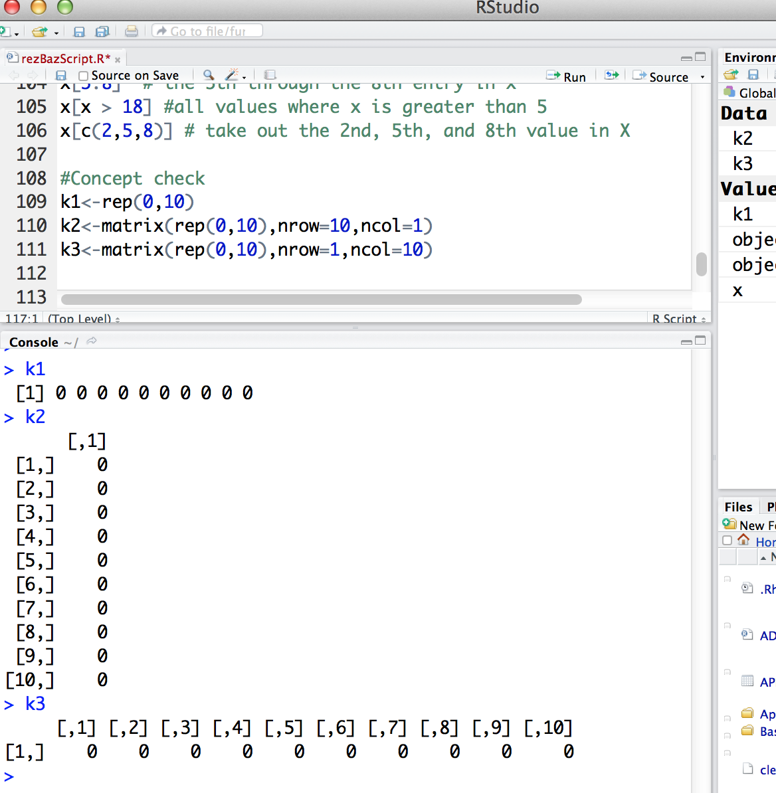

Slide 81
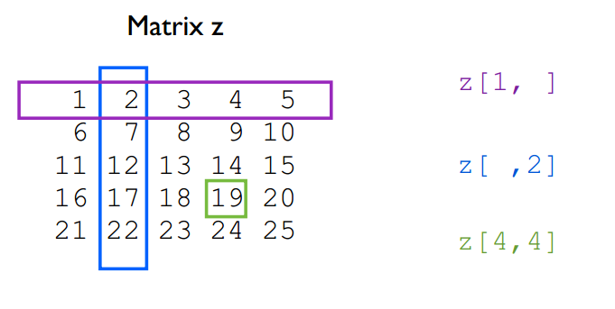
Subsetting a Matrix

Slide 82
Subsetting
Let “mat” be the name of our matrix
mat[1, ] # first row
mat[ ,2] # second column
mat[4,3] # 4th row and 3rd column
mat[mat > 5] # all values greater than 5
Note this is much different than mat > 5, which is a logical True/False test to find values greater than 5

Slide 83
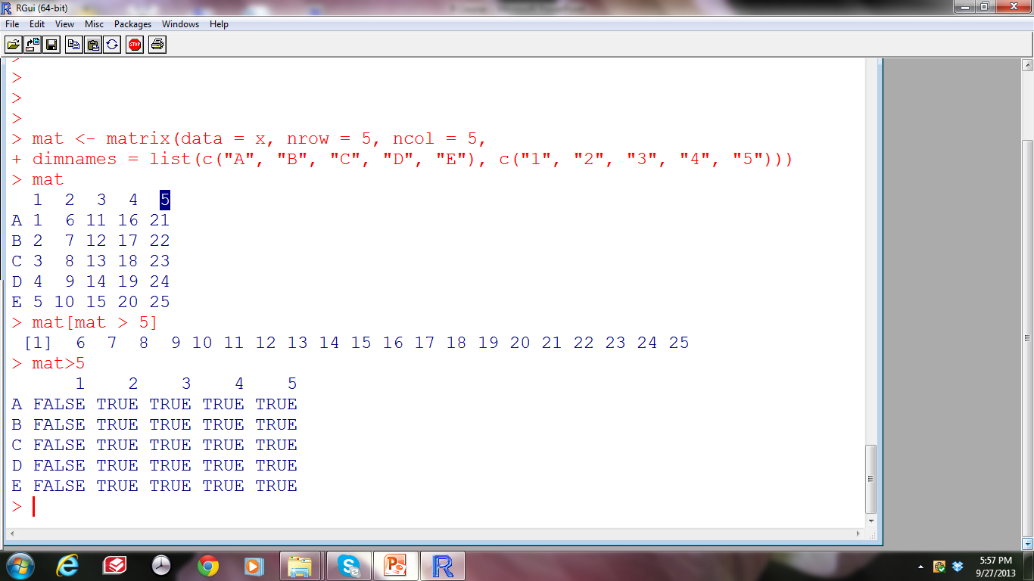
Subsetting a Matrix

Slide 84
Matrices do algebra similar to vectors – try it
mat1 <- matrix(1:25, nrow=5, ncol=5)
mat2 <- matrix(1:25, nrow=5, ncol=5)
> mat1 + mat2
> mat1 * mat2
> mat1^2

Slide 85
To do operations, matrices must have the same dimensions
> mat1 <- matrix(1:20, nrow=5, ncol=4)
> mat2 <- matrix(1:20, nrow=10, ncol=2)
>mat1 + mat2 # This will be an error

Slide 86
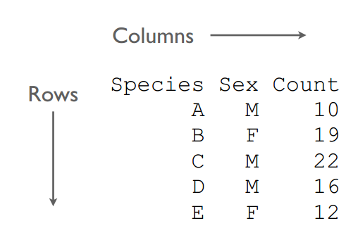
Data Frames
A data frame is similar to a matrix, but each column can be a different class (e.g., character, numeric, logical).

Slide 87
Creating a Data Frame
> number <- 1:5
> weight <- c(1.2, 2.0, 1.1, 1.9, 2.9)
> length <- c(25, 29, 26, 24, 30)
> sex <- c("M", "M", "F", "M", "F")
> dat <- data.frame(number, weight, length, sex)

Slide 88
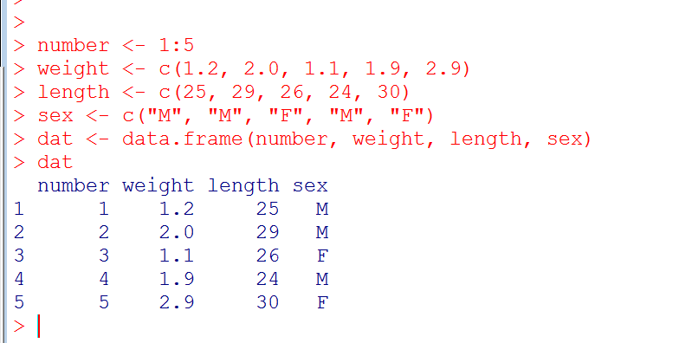
Creating a Data Frame

Slide 89
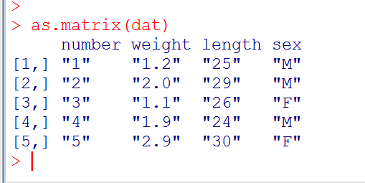
As a matrix this would look like:
The numbers are in quotes to represent characters – these numbers cannot do math operations.
Data frames allow us to have mixed data types

Slide 90
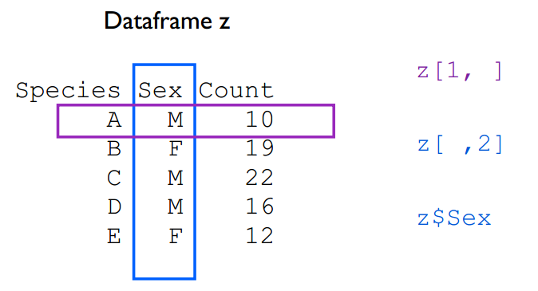
Subsetting Data Frames
We can use positional information dataframe[i,j], or variable names dataframe$variable name

Slide 91
R has some predefined data sets - lets load one
> iris
To see the variables in iris, we can look at the names associated with each column
>names(iris)

Slide 92
Try these.
Can you figure out what they’re doing?
> iris[1, ]
> iris[ ,1:2]
> iris$Species
> iris[iris$Species == "virginica", ]
> iris[iris$Sepal.Length < 5, ]
> subset(iris, Sepal.Length < 5)
> iris[iris$Species == "virginica" & iris$Sepal.Length <
6, ]
> iris[iris$Species=="virginica"|iris$Species=="setosa",]

Slide 93
Try these.
Can you figure out what they’re doing?
> iris[1, ] : First row
> iris[ ,1:2] : First and second column
> iris$Species : The column named “Species”
> iris[iris$Species == "virginica", ] : subset virginica
> iris[iris$Sepal.Length < 5, ] : subset all flowers with sepal
less than 5
> subset(iris, Sepal.Length < 5) : subset all flowers with sepal
less than 5
> iris[iris$Species == "virginica" & iris$Sepal.Length <
6, ] : subset virginica flowers with sepal length
less than 6
> iris[iris$Species=="virginica"|iris$Species=="setosa",] :
Subset species with names virginica or setosa

Slide 94
We can “attach” the variable names of the object
Sepal.Length
You get an error
attach(iris)
Now we do not need to specify the data frame
Sepal.Length
CAUTION: Masking can occur when attaching names to data frames. R redefines variables and will overide objects with the same name.

Slide 95
Concept Check
Subset the 17th row
What is the mean of Petal.Length of all species?
What is the median of Petal.Length for the setosa Species?
What is wrong with this command (try it and read the error message):
iris[iris$Species == "virginica"]

Slide 96
Concept Check Answers
iris[17,]
mean(iris$ Petal.Length)
Setosa<-iris[iris$Species==“setosa”,]
median(Setosa$ Petal.Length)
What is wrong with this command (try it and read the error message):
iris[iris$Species == "virginica"] #missing comma after
virginica

Slide 97
Lists
A list is an arbitrary collection of R objects
Different objects within a list are known as components
Lists can have components made up of vectors, matrices, arrays, dataframes, and other lists

Slide 98
Creating a list
mat <- matrix(1:25, 5, 5)
number <- 1:5
sex <- c("M", "M", "F", "M", "F")
lst <- list(mat=mat, number=number, sex=sex)
“Name of component”=“what component is filled with”

Slide 99
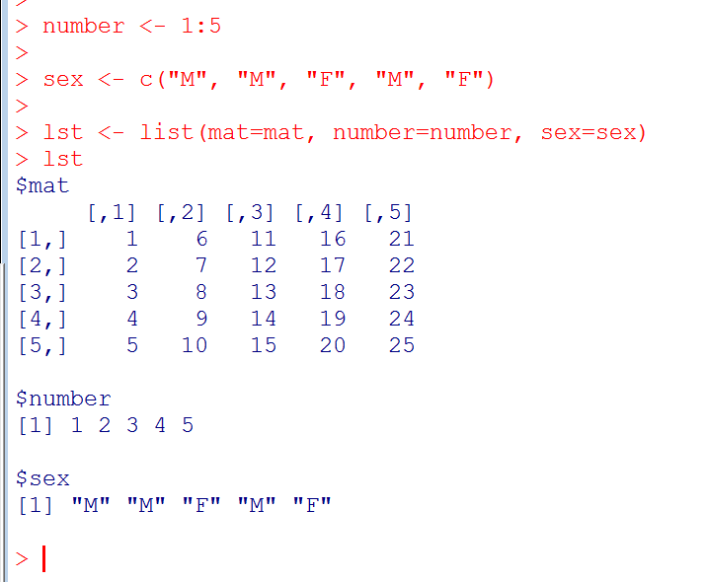

Slide 100
Subsetting Lists
SomeList[[component]]
SomeList$component
Only possible if you define a name
Compare:
> lst <- list(mat=mat, number=number, sex=sex)
> lst2 <- list(mat,number, sex)

Slide 101
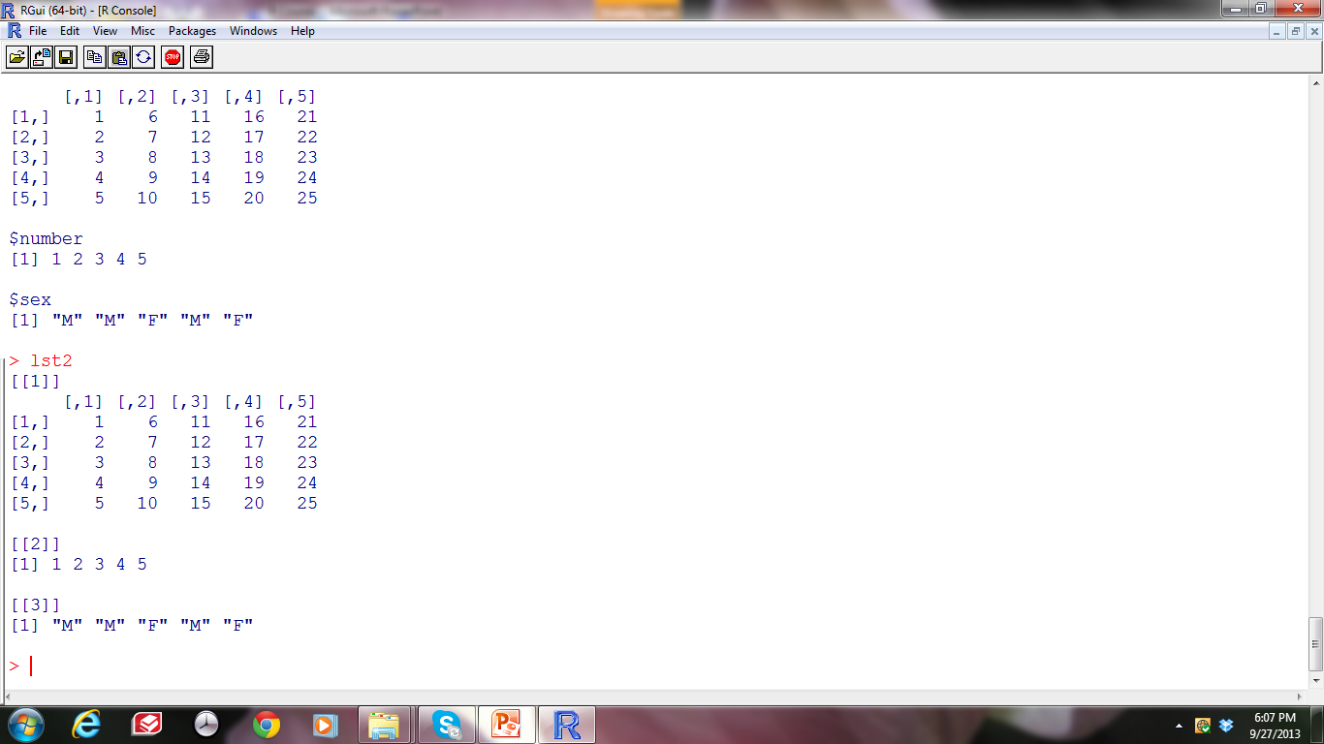
Compare in R

Slide 102
End Module 2
Questions?

Slide 103
Introduction to R – Part 2
Sponsored by: The Graduate Research Commons & KEY
Facilitator: Laura Gutierrez Funderburk & Alice Roberts

Slide 104
Module 3
Importing, Exporting, and Managing Data

Slide 105
The three most common data ﬁle formats compatible with R:
Comma separated value ﬁles (CSV)
Tab separated ﬁles
Space separated ﬁles

Slide 106
Recall
Reading Data: by default, R assumes the data is located in the working directory
Writing Data: by default, R will write all data ﬁles to the working directory
Stay organized and use a separate folder for every project

Slide 107
Export Data from R
As a space separated text file:
> write.table(iris, file = "iris.txt", row.names = FALSE, sep = " ")

Slide 108
Your Turn
Import iris data as a CSV.

Slide 109
Your Turn
Import iris data as a CSV:
> write.csv(iris, file = "iris.csv", row.names = FALSE)

Slide 110
Working with Excel
To read data stored in an Excel spreadsheet you need to save the ﬁle as a .csv ﬁle:
1. In Excel select "save as ..." under the ﬁle menu
2. Select the format "Comma Separated Values
(.csv)"

Slide 111
Reading Data into R
read.table(file, header = FALSE, sep = "", row.names, col.names, na.strings = "NA”,… )
read.csv(file, header = TRUE, sep = …)
File= pathway or file name if it is in the working directory
Header= False, the first row is data not column headings

Slide 112
Reading Data into R
Use the read.table() or read.csv() functions to get data into R.
Space delimited
> dat1 <- read.table(file = "iris.txt", sep = " ", header = TRUE)
Comma separated
> dat3 <- read.csv(file = "iris.csv”)

Slide 113
Data From a website
http://www.o3d.org/npgo/data/NPGO.txt
> npgo <- read.table( "http://www.o3d.org/npgo/data/NPGO.txt", header = FALSE)
Example courtesy of Mike Malick

Slide 114
To learn more
?read.table
?write.table

Slide 115
Our Turn
Let’s open the excel file called “mydata” with column headings:
department, height, age, gender
After adding some more data together, we’ll save it as a .csv file, open it in R, then import it from the working directory as a new R Object called “mydata”

Slide 116
Sourcing
Allows you to load (“call”) a series of commands and data directly to R
Allows you to take files that may not be saved in the same location and use them in functions or loops
The script must contain no errors

Slide 117
Sourcing
Make a new script. Add the following commands:
## Sourcing example
object3<-1:10
object4<-5+6
Save it as “sourceEx.r”
Exit and then re-open R. Make sure the working directory is set correctly then open your script from today and type the command “source(source.Ex.r)”
List your objects
ls()

Slide 118
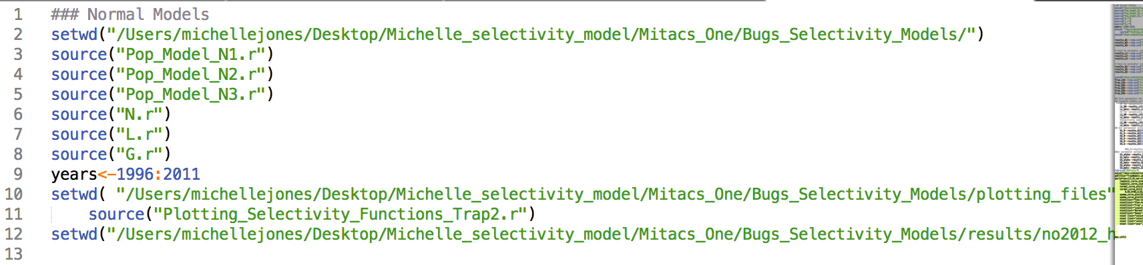
Sourcing
Example application of sourcing codes from various directories

Slide 119
Data Management- Sorting Data
Sort your data from smallest to largest:
sort(x, decreasing = FALSE, ...)
x = data
Decreasing= False ; start with the smallest value
x <- c(10, 11, 9, 6, 1, 13)
> sort(x)
> sort(x, decreasing = TRUE)

Slide 120
The order () function
order(x) # gives indices of rank
x[order(x)] # sorts based on order
“Take the value of X in the ordered position of X”
> x<- c(10, 11, 9, 1, 6, 13)
> order(x)
[1] 4 5 3 1 2 6
>x[order(x)] #
[1] 1 6 9 10 11 13
The first value in X, i.e. 10, is now positioned as the 4th element because it is the 4th largest value

Slide 121
Try it on our data
mydata[order(mydata$years), ]
mydata[order(mydata$height, mydata$years), ]

Slide 122
Adding columns
Use the $ sign with the name of the new column
mydata$log_height<- log(mydata$height)
# log transform all of the heights and save them as a new column

Slide 123
Missing Values
R uses the NA symbol to represent missing values
When reading in data ﬁles R automatically replaces blank cells with NA
NA values are handled differently than regular data points
x <- c(2, 3, 4, NA)
mean(x)
mean(x, na.rm = TRUE) # remove Nas during calculation

Slide 124
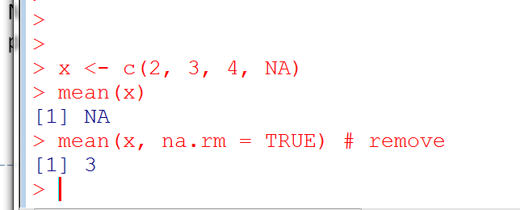

Slide 125
Dealing with Missing Data
x <- c(2, 3, 4, NA)
is.na(x) # see what values are missing
sum(is.na(x)) # count the missing values
!is.na(x) # is not an NA
na.omit(x)
x <- x[!is.na(x)] # save the values of X that are in the position of Non-missing values

Slide 126
Viewing pieces of your data
> head () # see the first few rows data
> tail () # see last few rows of data
> names() # see variables
> dim () # see the dimensions of your data
> length()#how long something is (ie # of entries)
> str() # structure of data

Slide 127
Your turn
Make the following dataset in excel:
Import it into R as object “mydata3.csv”
Take the mean value of C
Order the data set based on the descending order of variable C
A | B | C
10 | Y | 1
NA | Y | NA
30 | NA | 12
35 | G | 20

Slide 128
End Module 3
Questions?

Slide 129
Module 4: Plotting in R

Slide 130
Plot Arguments
plot(x, y, type = "p”,main = "Main-title",sub = "Sub-title", xlab = "X-lab",ylab = "Y-lab”)
X= the x variable
Y= the y variable
Type= draw as points, line “l”, histogram “h”, etc.
Main=tittle
X-lab = title of x axis
Y-lab = title of y axis

Slide 131
Graphs can be personalized in R.
options are endless….

Slide 132
Graphical parameters
background
labels
colors
margins of the plot
font type
font size
plotting characters
aspect ratios
tick marks
axis label rotation
number of plots
line type
line width
plot dimensions
box type ...

Slide 133
To get an idea of the options…
> help(par)
Now, let’s go through some of the common commands you’re likely to use

Slide 134
Compare the following
X<-1:6 Y<-7:12
> plot(x, y, pch=1, main=“my graph”, cex=1)
> plot(x, y, pch=3, main=“my graph”, cex=3)
> plot(x, y, type=“l”, lwd=1, main=“my graph”)
> plot(x, y, type=“l”,lwd=3, main=“my graph”)
Notes:
switch
1

Slide 135
To see more than one graph at the same time
par(mfrow=(i,j))
This function partitions the graph into i rows and j columns
Re-run our last 4 graphs after using
par(mfrow=c(2,2))
Notes:
switch
1

Slide 136
par(mfrow=c(2,2))
#Now put our old code
> plot(x, y, pch=1, main=“my graph”, cex=1)
> plot(x, y, pch=3, main=“my graph”, cex=3)
> plot(x, y, type=“l”, lwd=1, main=“my graph”, cex=1)
> plot(x, y, type=“l”, lwd=3, main=“my graph”, cex=3)

Slide 137
To learn some of the parameters we’re most likely to use, lets make a series of plots together using the USArrests Data and State region data
data(USArrests)
More datasets to try hands on:
https://stat.ethz.ch/R-manual/R-devel/library/datasets/html/00Index.html
Notes:
switch
1

Slide 138
The plot you get depends on the data structure
Dataframes will produce a scatterplot matrix
> plot(USArrests)

Slide 139
Single numeric variable will produce a scatterplot
> plot(Murder)
Single factor variables will produce a barplot
> data(state.region)
> plot(state.region)
you could also use
> hist(State)

Slide 140
A categorical variable and numeric variable will create a boxplot
> plot(state.region,UrbanPop)
A numeric and factor variable (dotplot)
> plot(UrbanPop, state.region)
Notes:
switch
1

Slide 141
Improving the defaults
plot(Murder, Rape)

Slide 142
Lets add a title and change the y labels
….main=“”, ylab=“”, xlab=“”,…
Go into your script and make the following changes:
plot(Murder, Rape, main=“US Arrest Rates",xlab=”Murder Arrests",
ylab=”Rape Arrests")
Notes:
switch
1

Slide 143
Make each point identifiable by state region
plot(Murder,Rape, main=“US Arrest Rates",xlab=”Murder Arrests”, ylab= ”Rape Arrests”, col=state.region, pch=as.numeric
(state.region), las=1)
las=1 will rotate the y axis labels
Notes:
switch
1

Slide 144
Add a Legend
To Add a Legend:
legend(x = “position”, y = “position”,c(”labels”),pch=“type of symbol”,col=c(“colors”),bty = “Type of legend frame",cex = “character expansion”)
Notes:
switch
1

Slide 145
legend(x = 0, y =50, legend = unique(state.region), pch= as.numeric(state.region), col=unique(state.region),bty = "n")
Notes:
1

Slide 146
Test your knowledge
Move the legend to the top right corner
Hint: Must update x y coordinates.

Slide 147
Add a reference line
abline(lm(Rape~Murder))
* Note that models are in the form Y~X versus points, which are in the form X,Y
Notes:
switch
1

Slide 148
Word Clouds

Slide 149
Word Clouds
The code to make word clouds is within a package
Packages are pre-written code that we can use through user functions to do specific analyses
To install a package, we use the command install.packages
> install.packages(“wordcloud”)
Once downloaded, packages must be loaded from the R library
> library(“wordcloud”)

Slide 150
Default Arguments:
wordcloud(words,freq,scale=c(4,.5), min.freq=3,
max.words=Inf, random.order=TRUE, random.color=FALSE, rot.per=.1, colors="black", ordered.colors=FALSE, Use.r.layout = FALSE, fixed.asp=TRUE, ...)

Slide 151
Example
Make the following two vectors
> words<-c(“test”, “pass”, ”fail”, ”stress”, “panic”, ”relief”, ”silence”, ”paper”, ”multiple choice”, “answers”)
> Freq<-c(11, 15, 12, 13, 18, 9, 22, 8, 8, 6)
> wordcloud(words, Freq)
Notes:
switch
1

Slide 152

Concept Check
Draw a worcloud with words whose frequency > 10
Hint: use help(wordcloud)
Change the color of wordcloud to red

Slide 153
Module 5: Basic Statistics in R

Slide 154
Built in modeling functions
> lm() # linear model
> aov() # anova
> manova() #manova
> pca() #principle component analysis
> glm() # general linear model

Slide 155
Linear models
lm(formula, data, subset, weights, na.action, model = TRUE, ...)
formula: y ~ x1 + x2 ...
Response variable is on the left
Predictor variables are on the right

Slide 156
Load the state.x77 data set
> data(state.x77)
Explore the data and save into a dataframe (currently a matrix)
> testDat<- as.data.frame(state.x77)
>head(testDat)
> tail(testDat)
Then add an additional column of data:
>testDat$region<-as.vector(state.region)
Notes:
Switch
Dataset related to 50 states of USA
State.region is another dataframe giving north south west east for all 50 states/
1

Slide 157
Check and Fix Data Classes
class(testDat$Income)
class(testDat$region)
testDat$region<-as.factor(testDat$region)
Notes:
switch
1

Slide 158
Correlation Coefficients
> cor(testDat[,1:7]) # get correlation among variables
Why did we only include the first 7 columns?
Notes:
switch
1

Slide 159
Anova analysis
Test to see if mean income varies by region:
> aov_region <-aov(testDat$Income~as.factor(testDat$region))
> summary(aov_region)

Slide 160
Simple Linear Model
Does high school graduation rate and region have an effect on income?
> fit1<-lm(testDat$Income~testDat$"HS Grad"+testDat$region)
> anova(fit1)
Notes:
1

Slide 161
Extracting specific information
names(fit1) # see what information is saved
fit1$residuals # get the residuals of the model
fit1$coefficients
fit.sum <- summary(fit1) #place all the output in an object
names(fit.sum)
fit.sum$r.squared #get r.squared
Notes:
switch
1

Slide 162
Other general functions
plot(fit1)# series of quantile and fitted plots
coef(fit1)#extract the coefficients
residuals(fit1) #extract residuals
fitted(fit1) #get fitted values
vcov(fit1) # variance and covariance
confint(fit1)# confidence interval for parameters
Notes:
switch
1

Slide 163
Logistic Regression – Binary data
Load the restdat.csv data file
> rest_data<-read.csv(“restdata.csv”)
Notes:
1

Slide 164
The GLM Function in R
glm(formula, family = gaussian, data….)
Formula: The relationship being tested in the form y~x
Family: error distribution. In the case of binomial data (yes no, 0,1, etc) this will be binomial.

Slide 165
Try the following:
> fit1<-glm(rest_data$eat_out~rest_data$weight, family=binomial )
> fit1
> summary(fit1)
Notes:
switch
1

Slide 166
Extract the fitted values
> fit_values<-fitted.values(fit1)
> fit_values
Use the log-odds (probability of the event) to determine whether the model would suggest the person ate out or not based on a threshold probability (e.g. 50%):
> index<-rep(0,length(rest_data[,1]))
> index
> index[fit_values>.5]<-1
> index
Notes:
Switch ; fitted values are the probability of the event occuring i.e. 0: ate out or 1: did not eat out.
1

Slide 167
Confusion Matrix
 | Predicted No (Doesn’t eat out - 0) | Predicted Yes (Eats out - 1)
Actual no (Doesn’t eat out -0) | Correct | Type II error
Actual yes (Eats out -1) | Type I Error | Correct
Notes:
x
1

Slide 168
Confusion Matrix
First make a new object to compare the true values with the predictions from the model:
> confused<-cbind(rest_data$eat_out,index)
Then use logicals we’ve already learned with the sum() function!
Notes:
expain cbind and rbind (if not already covered)
1

Slide 169
Confusion Matrix
 | Predicted No (Doesn’t eat out - 0) | Predicted Yes (Eats out - 1)
Actual No (Doesn’t eat out -0) | Correct sum(confused[,1]==0&confused[,2]==0) | Type II error sum(confused[,1]==0&confused[,2]==1)
Actual Yes (Eats out -1) | Type I Error sum(confused[,1]==1&confused[,2]==0) | Correct sum(confused[,1]==1&confused[,2]==1)
Notes:
Switch
1

Slide 170
Confusion Matrix
 | Predicted No (Doesn’t eat out - 0) | Predicted Yes (Eats out - 1)
Actual No (Doesn’t eat out -0) | Correct 20 | Type II error 7
Actual Yes (Eats out -1) | Type I Error 12 | Correct 9
Notes:
Get help on rocc package
1

Slide 171
Compare models
Make two additional models:
> fit2<-glm(rest_data$eat_out~rest_data$gender,
family=binomial)
> fit3<-glm(rest_data$eat_out~rest_data$weight+rest_data
$gender, family=binomial)
Extract AIC Table:
> AIC_Table<-AIC(fit1,fit2,fit3) #AIC value is estimator of quality of stat models
Sort the Table to find the lowest score
> AIC_Table[order(AIC_Table$AIC),] #lower AIC indicates better fit
Notes:
Switch; explain what aic values are and if they r supposed to be the least possible values for better models
1

Slide 172
End Module 5

Slide 173
General Trouble-Shooting Tips
Check the working directory and make sure you’re data is there.
getwd()
Check your workspace to make sure objects you are referencing actually exist
Check capitalization and spelling
Check the class of data to make sure the function you’re trying to perform will work
(class() or str() )
Save your Workspace after every Rstudio session.

Slide 174
Thank you ☺

